Slide 1
Blockchain-Based Voting System
Presented By-
Shruti Pandey(CSE-SF)
Mudrika Pandey(CSE-SF)
Under the supervision of-
Dr. Girish Chandra(H.O.D.)
Ms. Diksha Sharma (Asst. Professor)

Slide 2
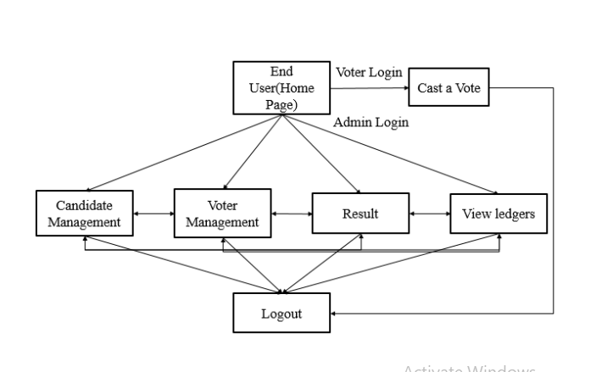
BLOCK DIAGRAM

Slide 3
PROGRAMMING LANGUAGE USED→
For Smart Contract: Solidity
Frontend: HTML, CSS, JavaScript
Development Tools→
Ganache
Truffle
Meta mask

Slide 4
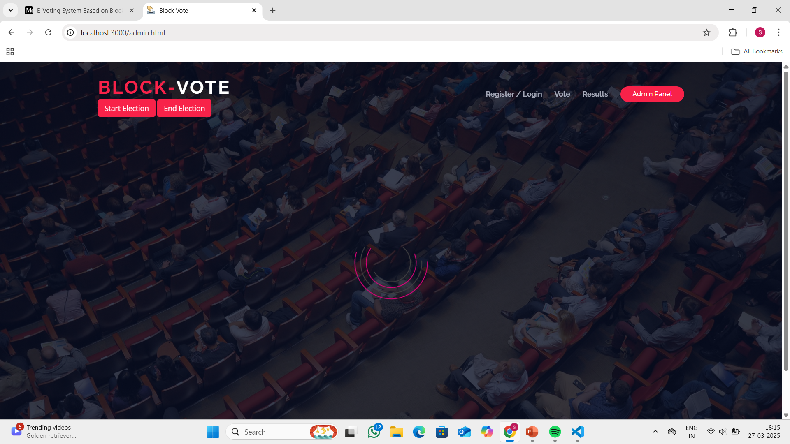

Slide 5
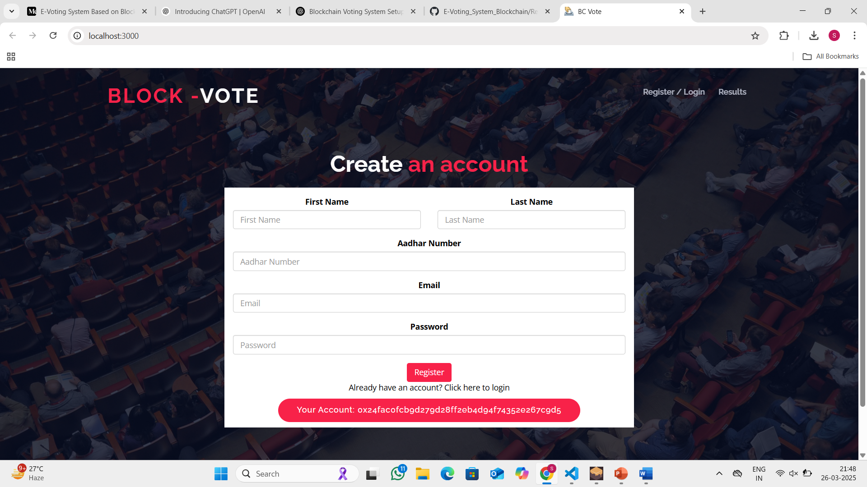

Slide 6
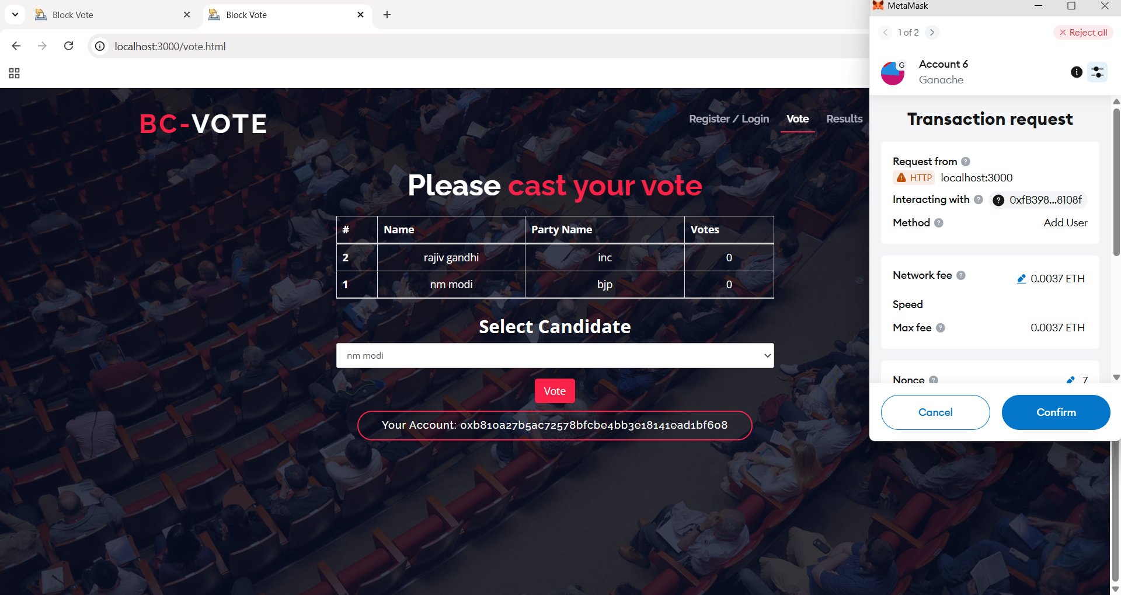

Slide 7
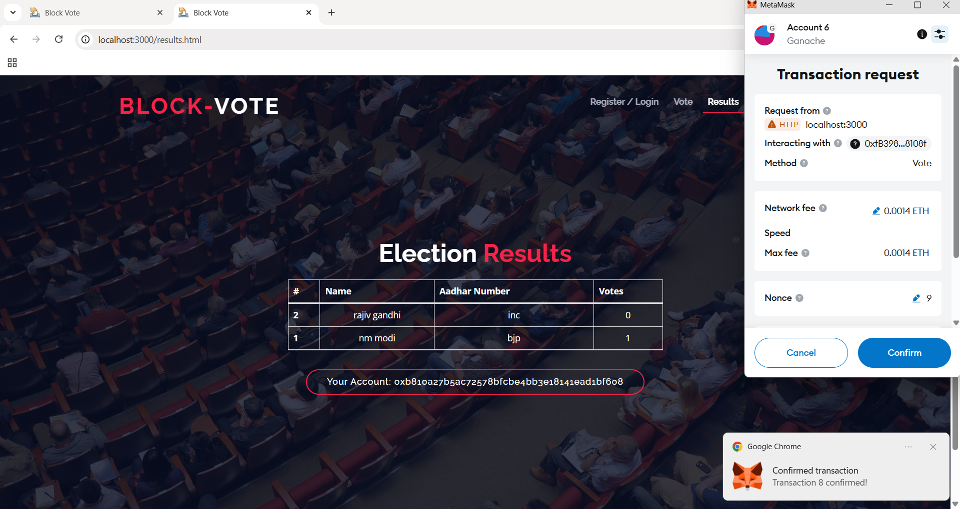

Slide 8
THANK YOU

